Slide 1
State Transition Extraction Flowchart
Detect Nodes and Text within them
Extract bounding boxes corresponding to texts outside circle
Detect blobs (endpoints of arrows)
Detect transitions/ lines/arrows from image.
Associate each blob with closest line.
Associate each line with closest text box
Merge lines which are associated with same text box
Associate each transition with closest node.
Find combination of Nodes, blobs, transitions and textbox associated with arrow.

Slide 2
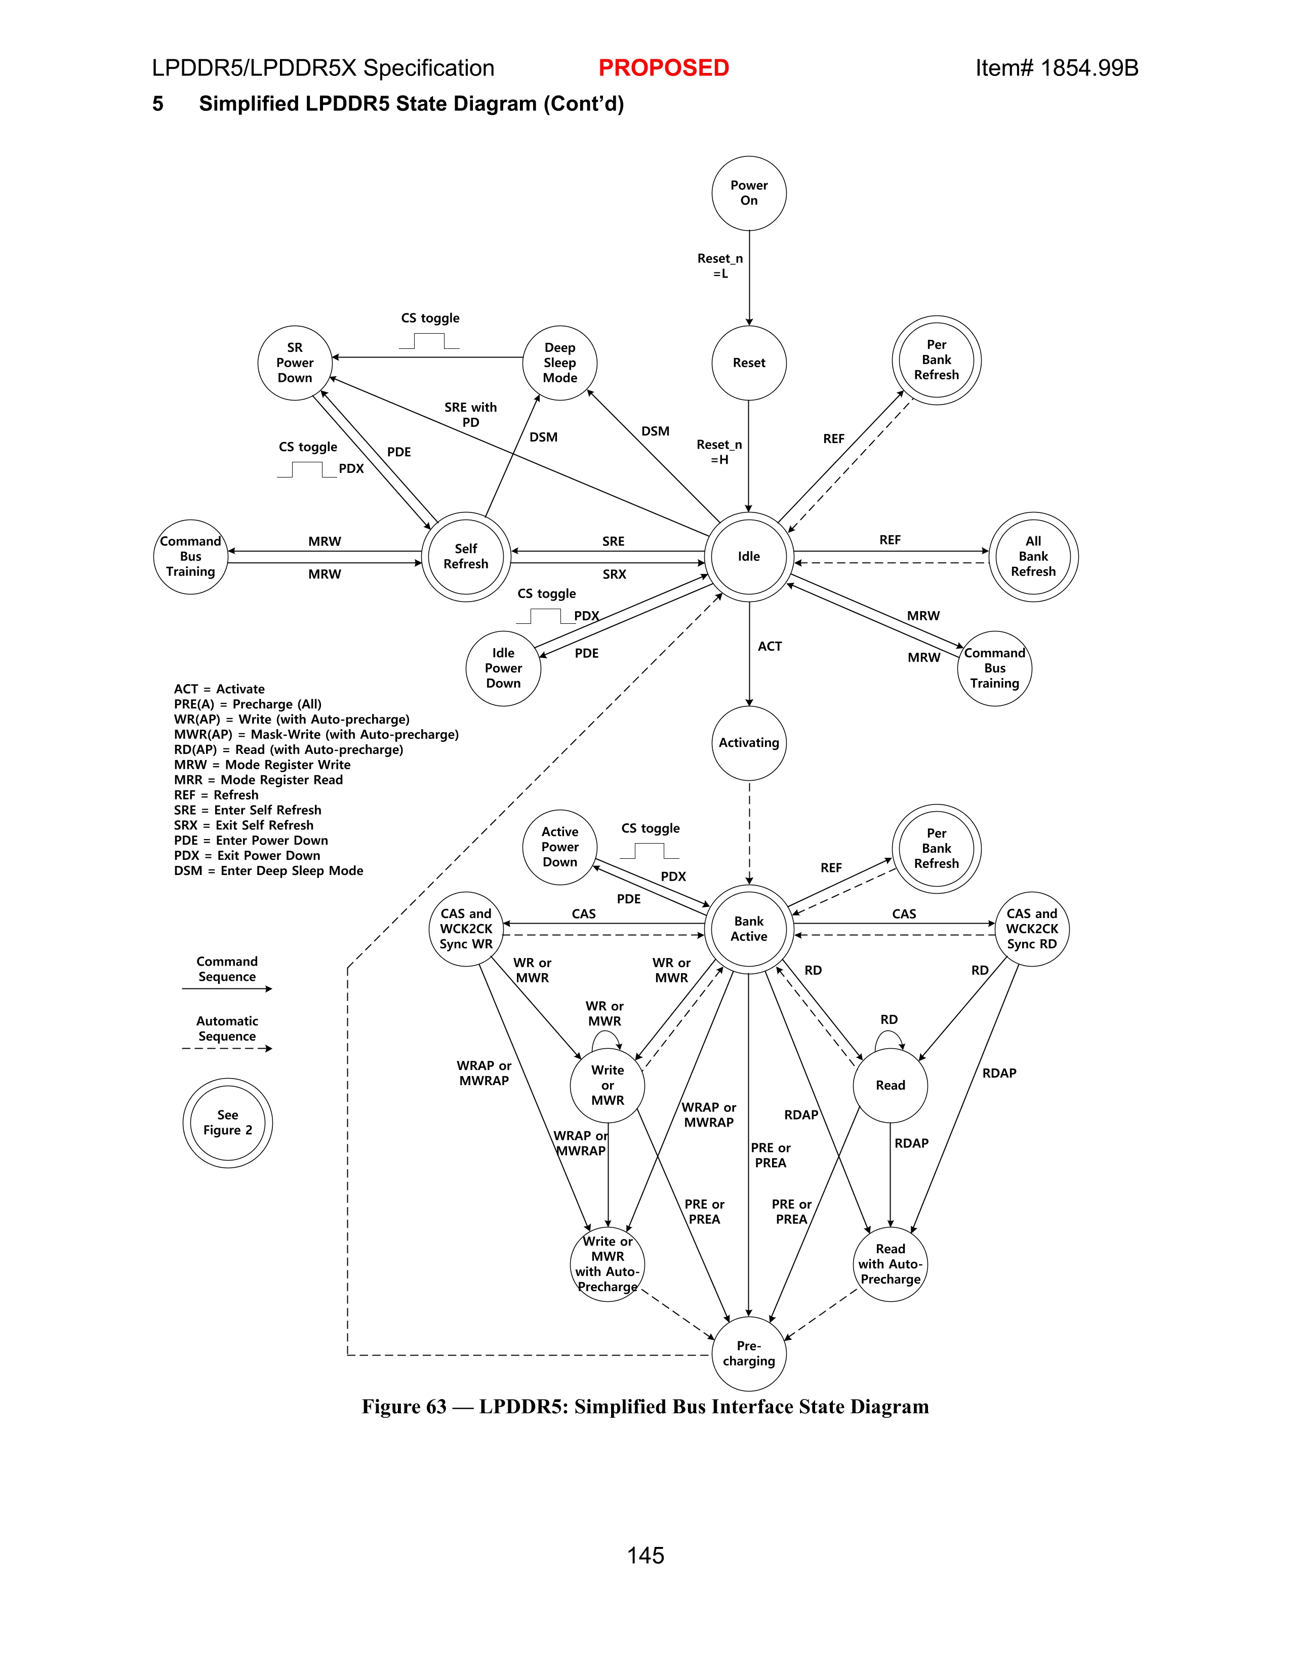
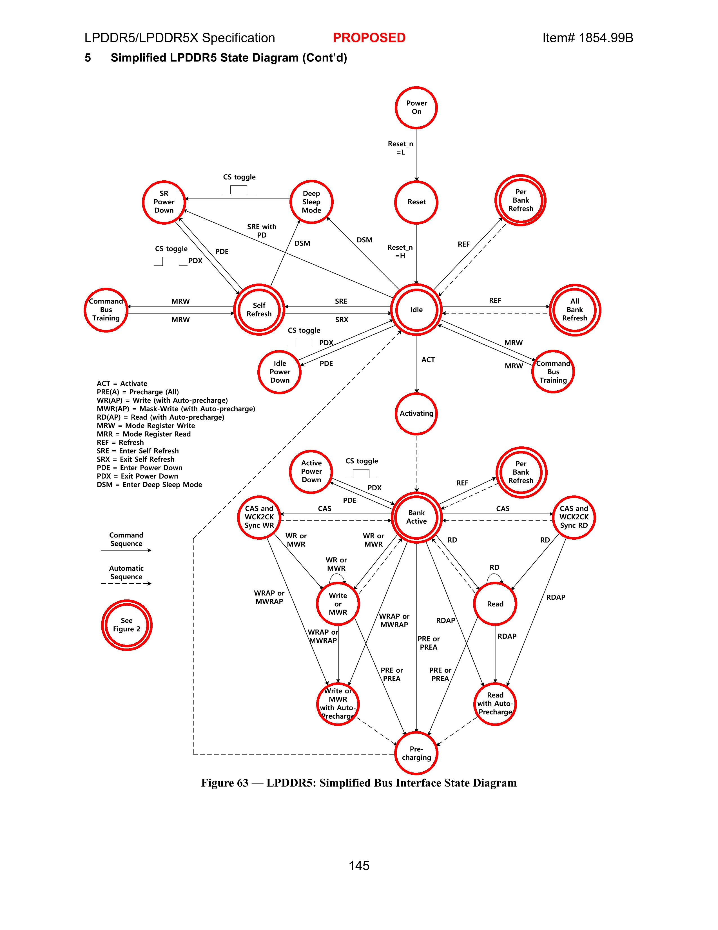
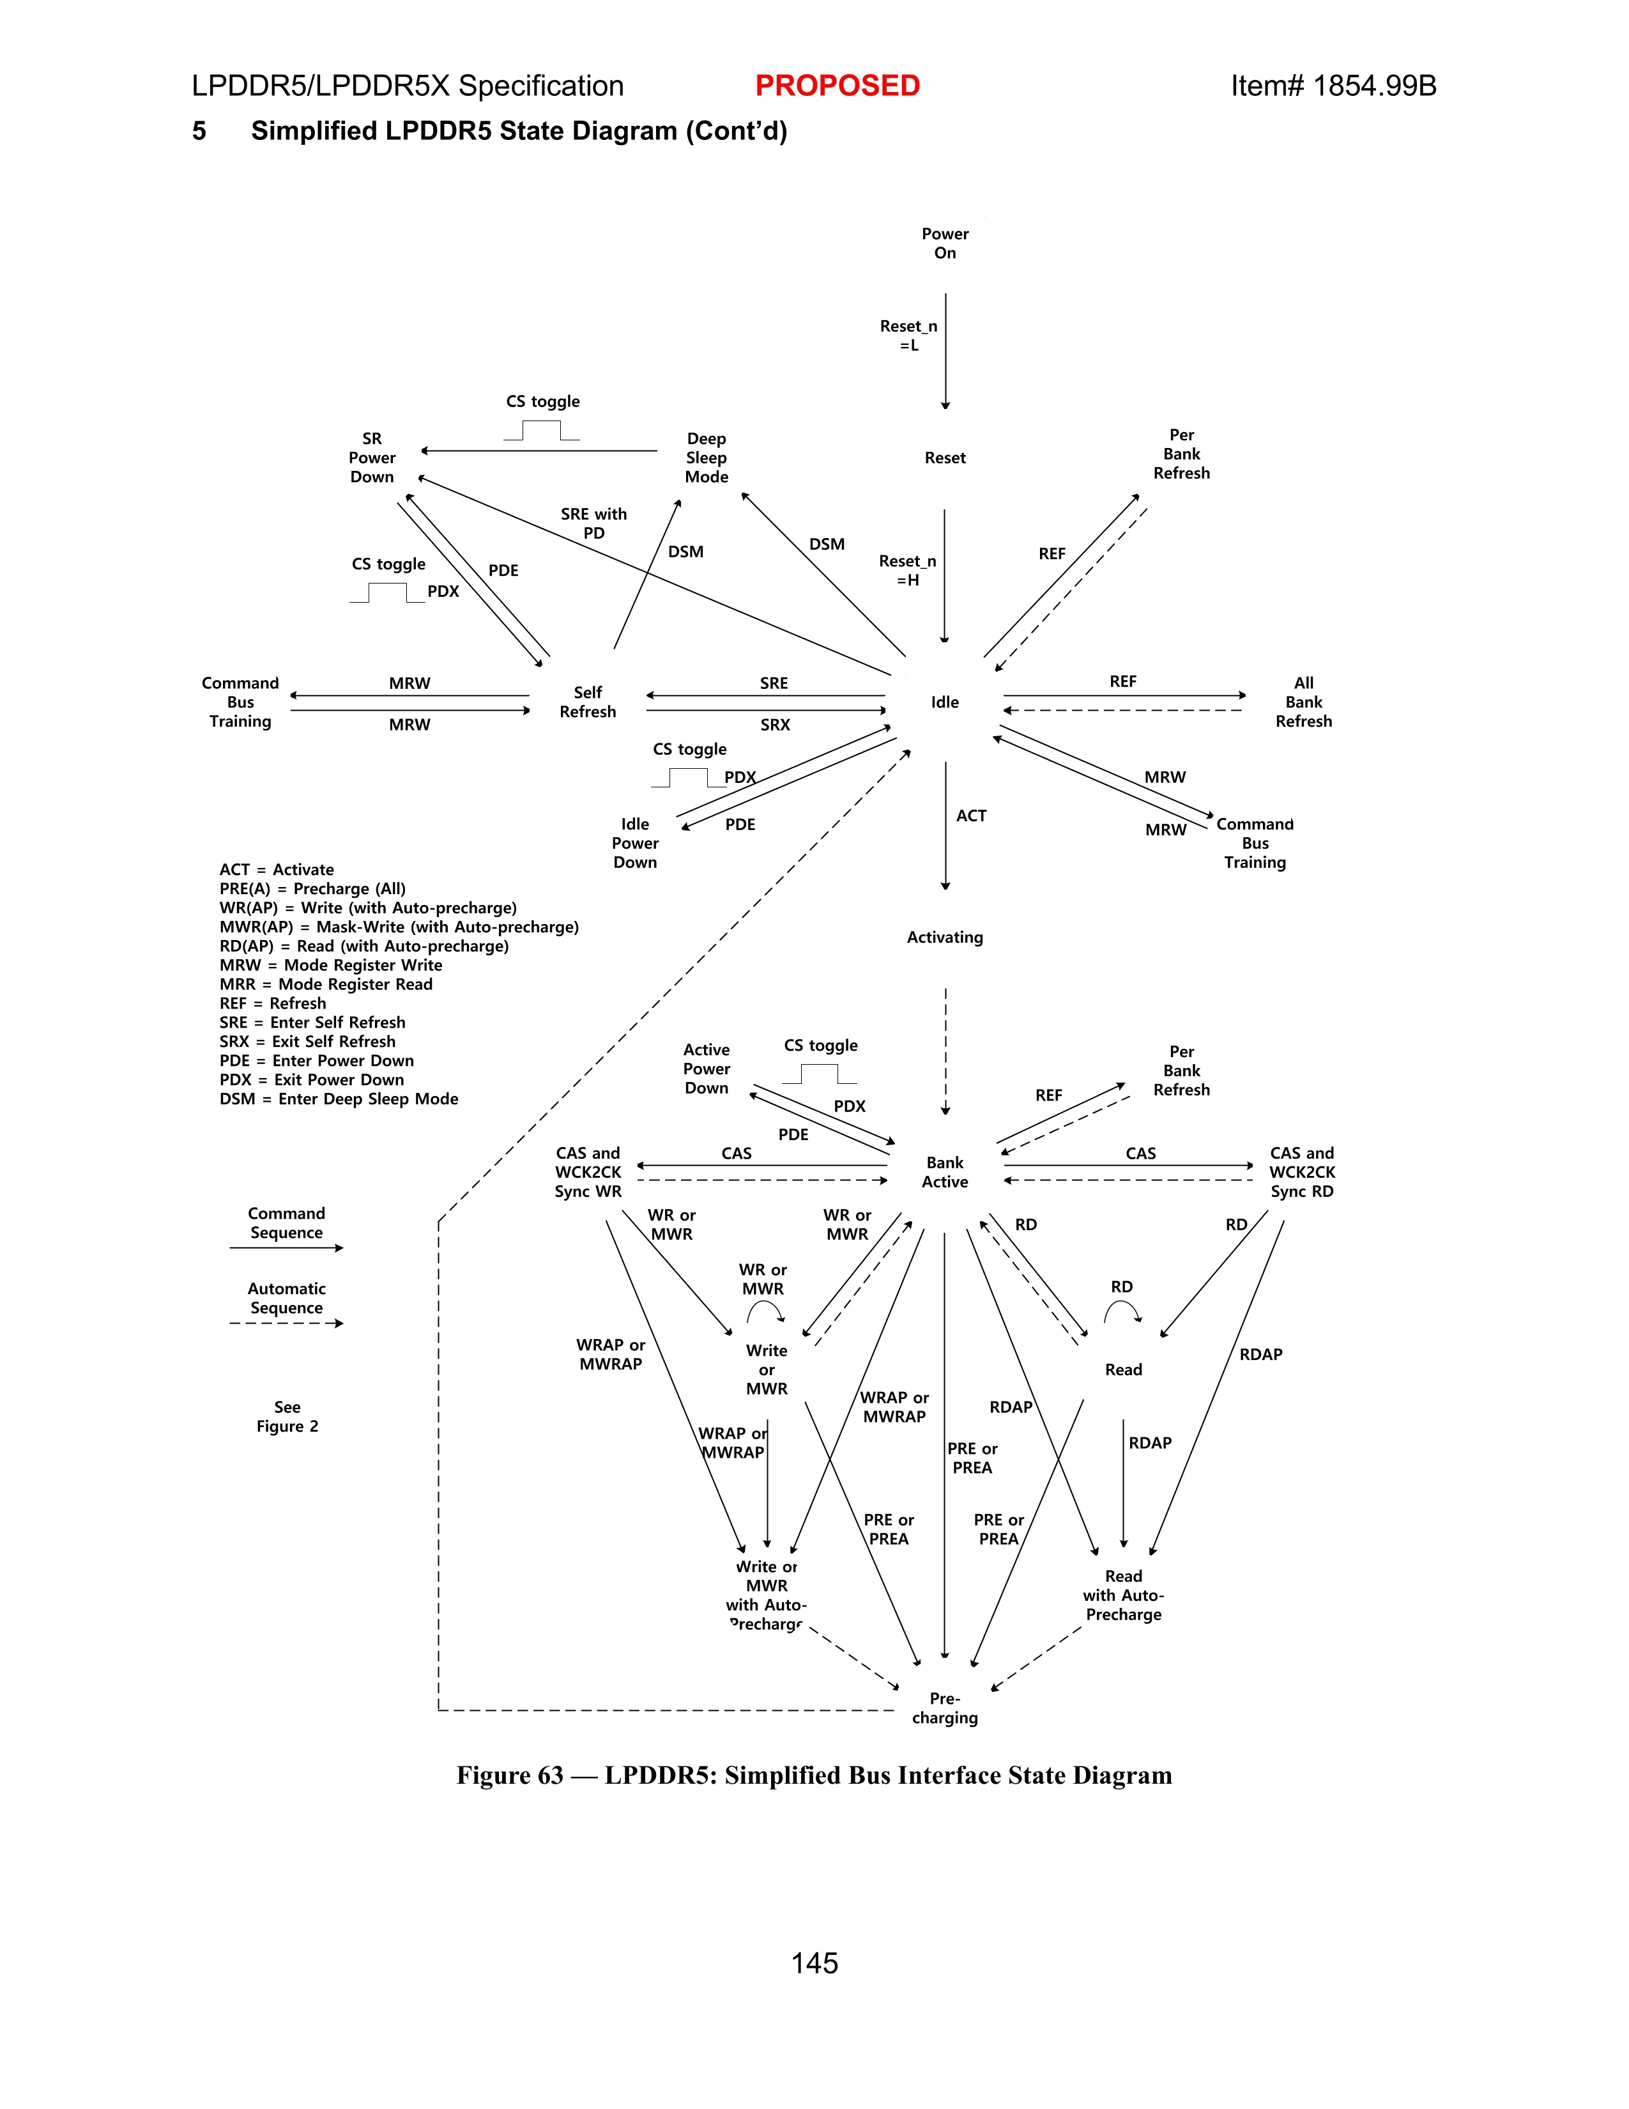
Extraction of state transition diagram
Step1: Simplified State Transition Diagram highlighting Transitions from one state to another
Step2: Node Detections (Double circle to detect if the nodes expand further)
Step3: Remove Nodes (to avoid Contour overlap) and Skeletonize the image.

Slide 3
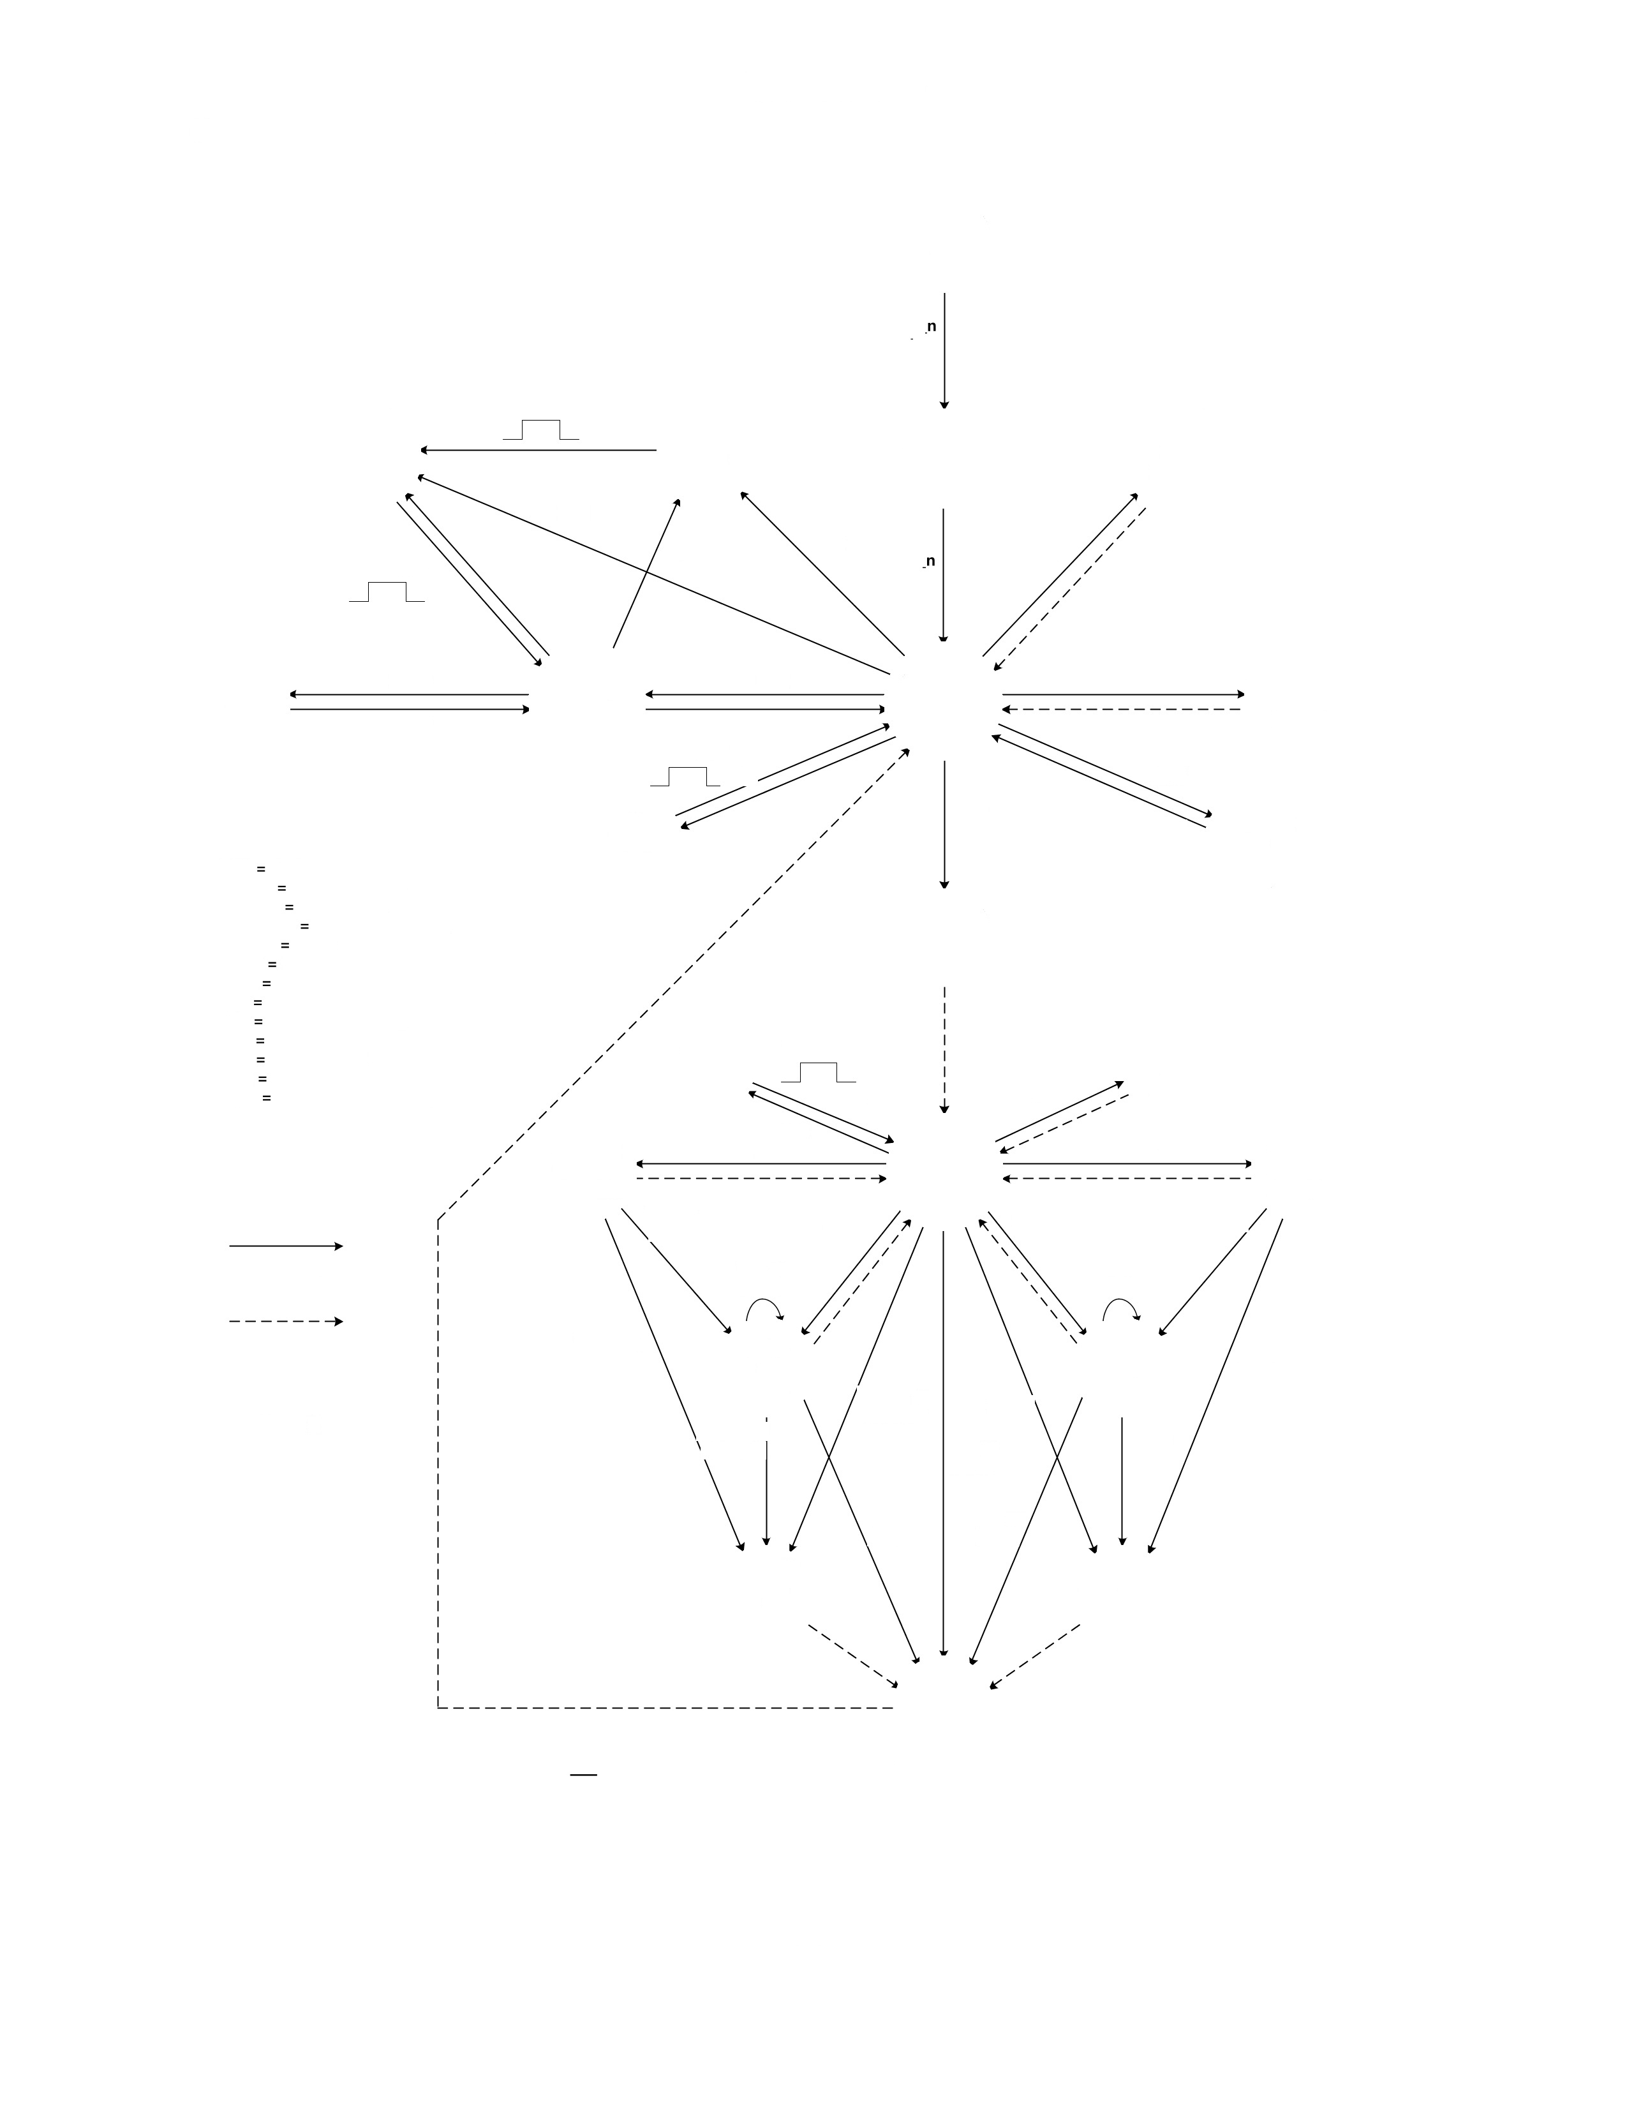
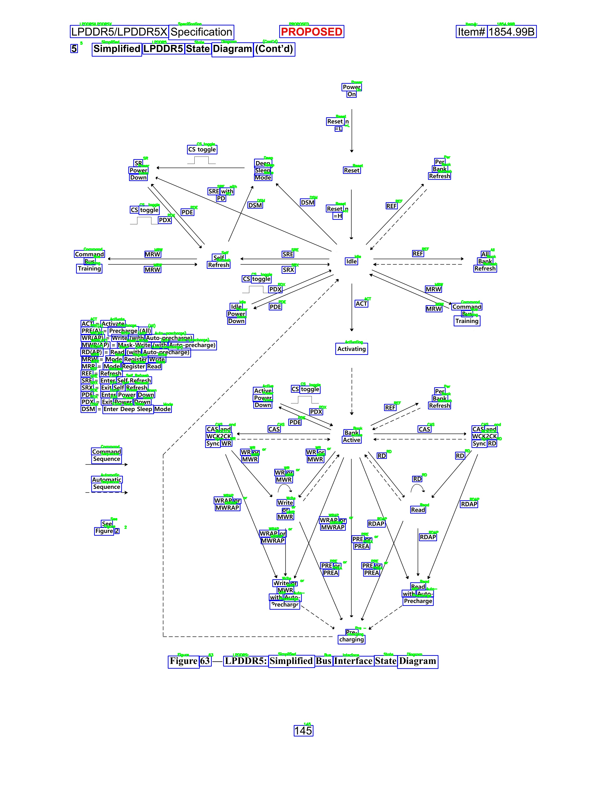
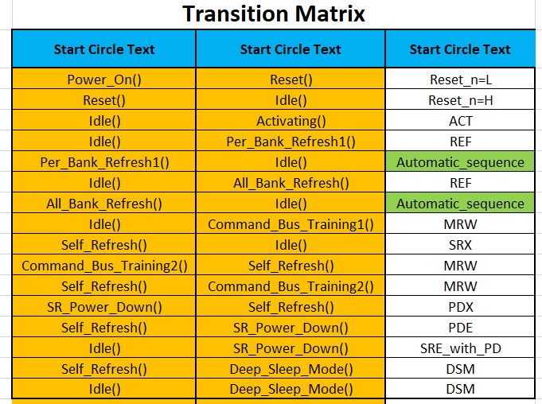
Extraction of state transition diagram
Step4: Arrow Detections (Overlapping Arrows, Broken Arrows, Different directions), Detect arrow start, end, Directed Graph
Step5: Optical Character Recognition (to understand and detect all the text present in the image for nodes and commands)
Step6: Linking nodes, text and commands together and capture it into a Transition Matrix

Slide 4
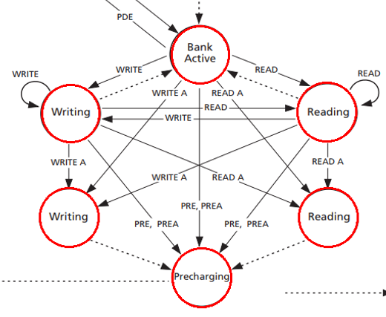
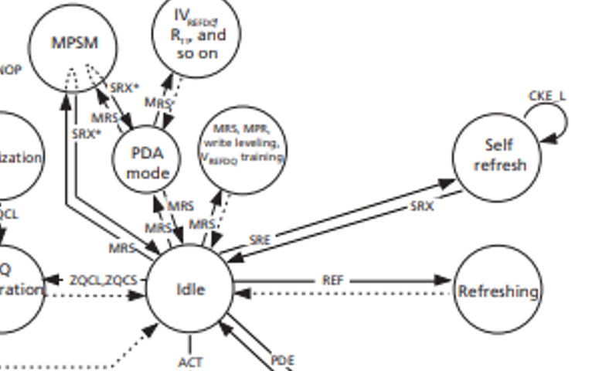
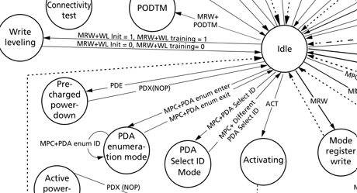
Limitations of Existing Solution
Limited extractions in case of broken arrows (text within the arrows)
Allows and text closely overlap, difficult to associate text to correct arrow when densely packed.
Tilted text recognized incorrectly.
Broken Arrows
Text and Arrows Overlap
Tilted Text

Slide 5
Waveform Extraction Flowchart
Waveform Image Localization
Waveform Image Extraction
Custom Kernelization for filtering
Linking PDF text to Image Arrows
Extracting Text from PDF
CNN Model to classify Arrow V/S Non-arrows
Linking Pins Information
Linking Command to Command for each timing
Conversion to Excel file

Slide 6
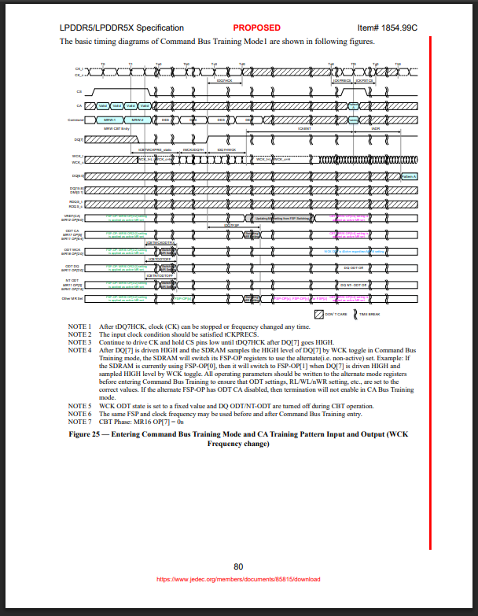
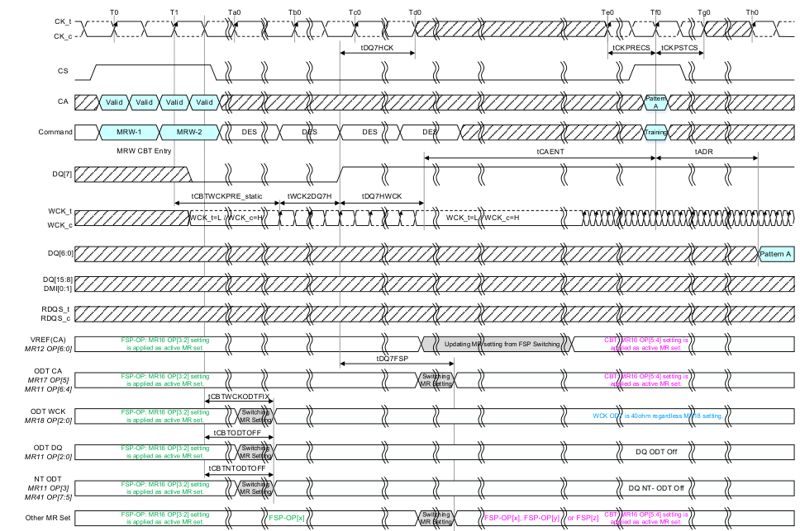
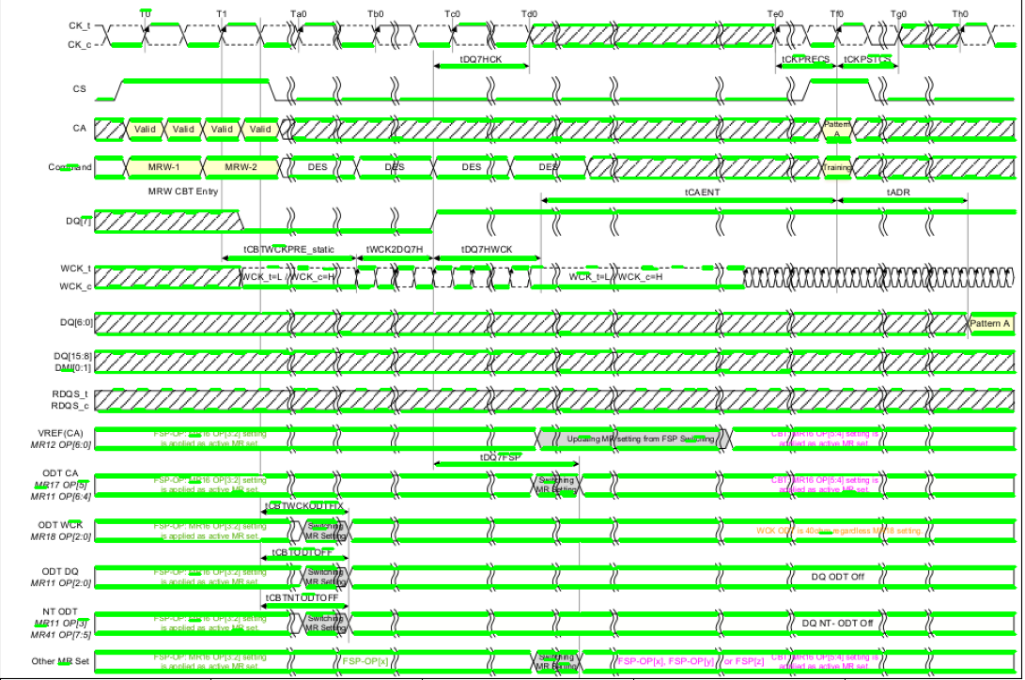
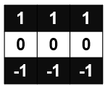
Waveform Extraction
Step1:
From the given PDF, waveform is located and extracted as a single image.
This detection is done using the post processed text data.
Step2:
Multiple waveforms on the same image also handled.
Each waveform is extracted as a separate image.
A Custom Horizontal Kernel of size 3x3 is swept across the image and all the horizontal lines are filtered out.
Step3:
Each Horizontal line is stored as a separate patch of the image.
Each Horizontal line is stored as a separate patch of the image.
Step4:
A CNN model (3 layered CNN) with binary cross entropy loss is function is trained to predict weather each patch is an arrow V/S non-arrow.

Slide 7
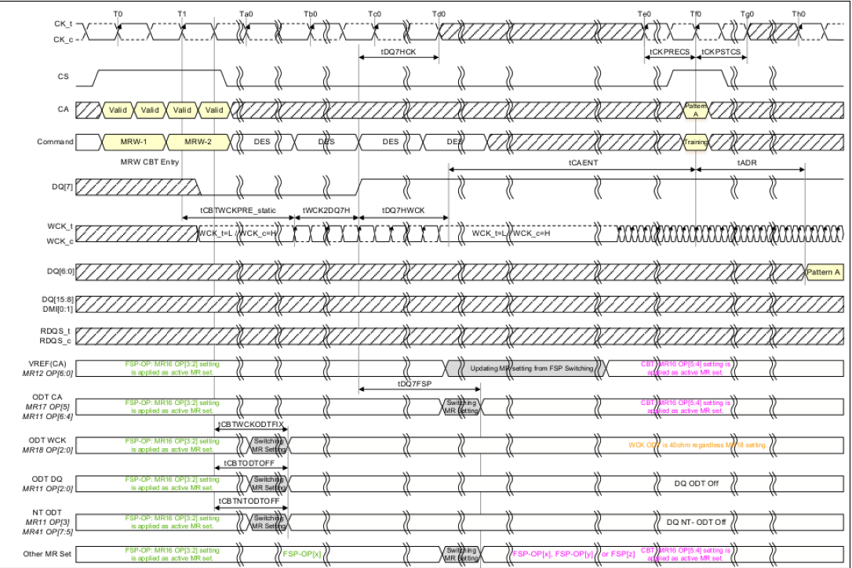
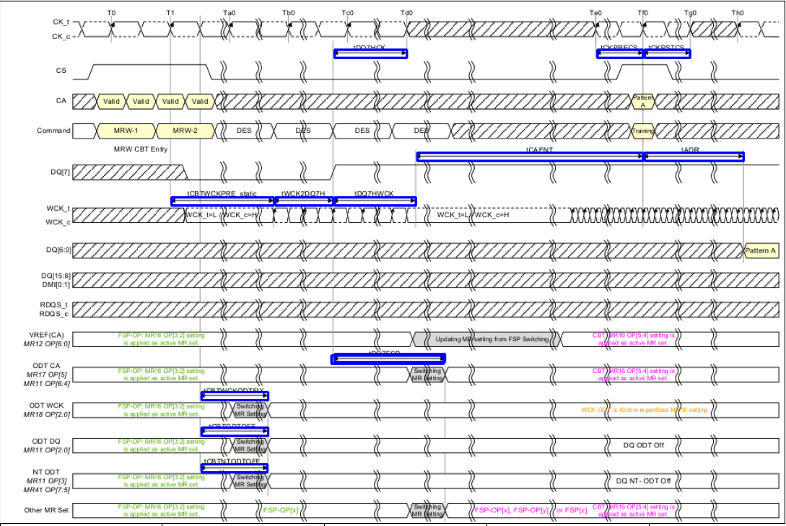
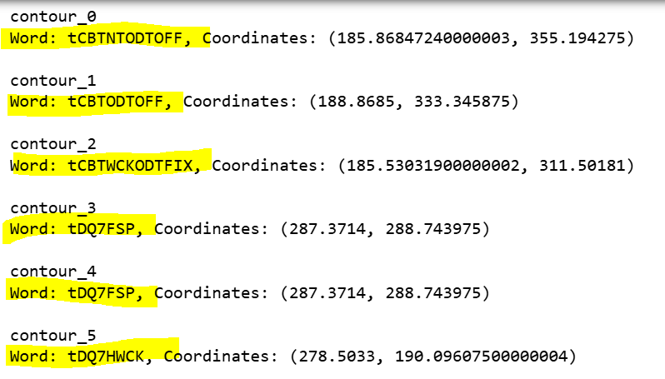
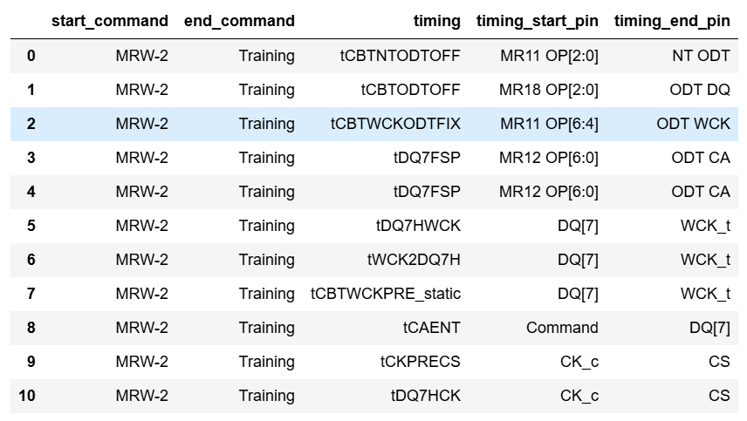
`
``
``
``
``
`
`
`
`
``
`
`
`
``
``
``
``
``
``
``
``
``
`
``
``
`
``
``
`
``
`
``
``
Step5:
Text is extracted from PDF using PDFPlumber (uses source code of PDF)
Text information about pins present in left vertical section of the image are extracted (Blue Boxes).
Common-to-command information is extracted.
Step6:
Text extracted for timing is mapped to the arrows detected.
Arrows detected + Timing information are mapped to the Clock pins and Start/ End command.
Step7:
All information is linked together to get the C2C Timing data for each waveform.

Slide 8
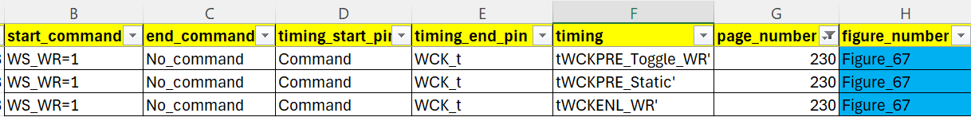
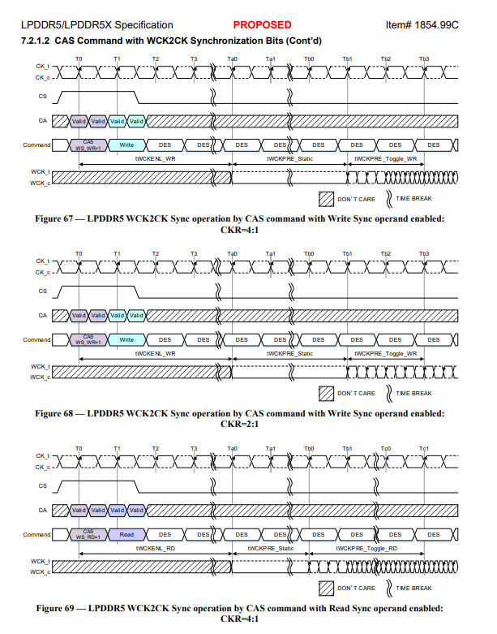
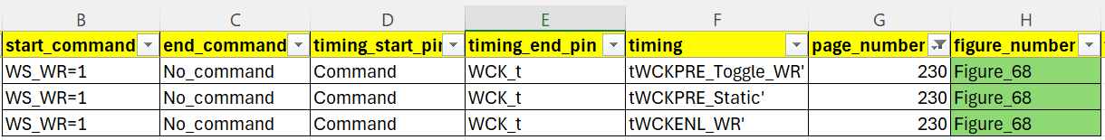
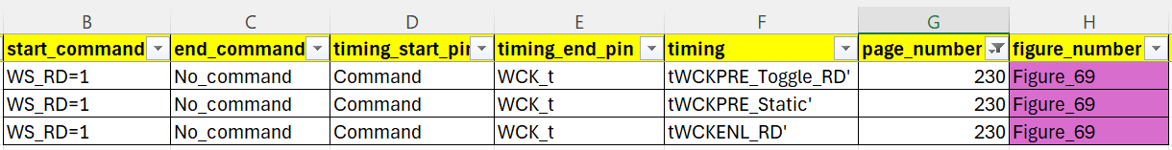
Waveform Extraction: More Examples
(Multiple waveforms on same page)
Similar results generated on all 335 images from JEDEC.
Additional information related to Bank/ BG Group/ DVFSQ/ CS ODT etc. are also captured for each waveform.

Slide 9
State Transition Extraction Flowchart
Detect Nodes and Text within them
Extract bounding boxes corresponding to texts outside circle
Detect blobs (endpoints of arrows)
Detect transitions/ lines/arrows from image.
Associate each blob with closest line.
Associate each line with closest text box
Merge lines which are associated with same text box
Associate each transition with closest node.
Find combination of Nodes, blobs, transitions and textbox associated with arrow.

Slide 10
Extraction of state transition diagram
Step1: Simplified State Transition Diagram highlighting Transitions from one state to another
Step2: Node Detections (Double circle to detect if the nodes expand further)
Step3: Remove Nodes (to avoid Contour overlap) and Skeletonize the image.

Slide 11
Extraction of state transition diagram
Step4: Arrow Detections (Overlapping Arrows, Broken Arrows, Different directions), Detect arrow start, end, Directed Graph
Step5: Optical Character Recognition (to understand and detect all the text present in the image for nodes and commands)
Step6: Linking nodes, text and commands together and capture it into a Transition Matrix

Slide 12
Waveform Extraction Flowchart
Waveform Image Localization
Waveform Image Extraction
Custom Kernelization for filtering
Linking PDF text to Image Arrows
Extracting Text from PDF
CNN Model to classify Arrow V/S Non-arrows
Linking Pins Information
Linking Command to Command for each timing
Conversion to Excel file

Slide 13
Waveform Extraction
Step1:
From the given PDF, waveform is located and extracted as a single image.
This detection is done using the post processed text data.
Step2:
Multiple waveforms on the same image also handled.
Each waveform is extracted as a separate image.
A Custom Horizontal Kernel of size 3x3 is swept across the image and all the horizontal lines are filtered out.
Step3:
Each Horizontal line is stored as a separate patch of the image.
Each Horizontal line is stored as a separate patch of the image.
Step4:
A CNN model (3 layered CNN) with binary cross entropy loss is function is trained to predict weather each patch is an arrow V/S non-arrow.

Slide 14
`
``
``
``
``
`
`
`
`
``
`
`
`
``
``
``
``
``
``
``
``
``
`
``
``
`
``
``
`
``
`
``
``
Step5:
Text is extracted from PDF using PDFPlumber (uses source code of PDF)
Text information about pins present in left vertical section of the image are extracted (Blue Boxes).
Common-to-command information is extracted.
Step6:
Text extracted for timing is mapped to the arrows detected.
Arrows detected + Timing information are mapped to the Clock pins and Start/ End command.
Step7:
All information is linked together to get the C2C Timing data for each waveform.

Slide 15
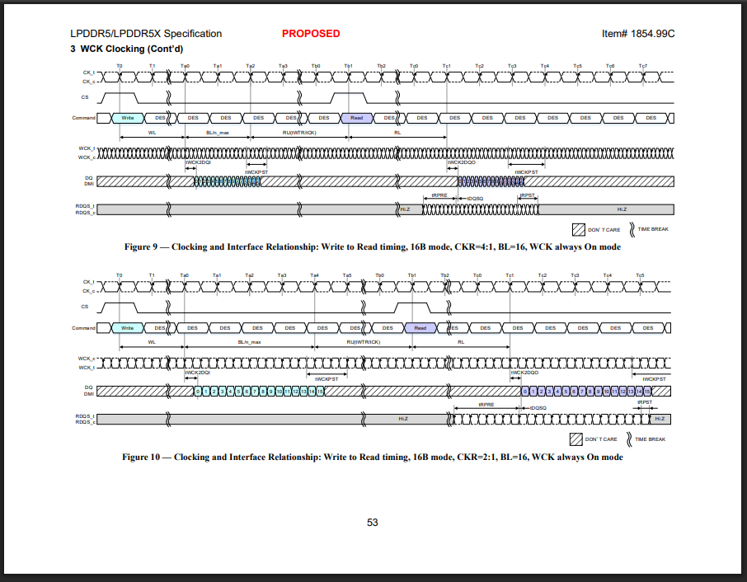
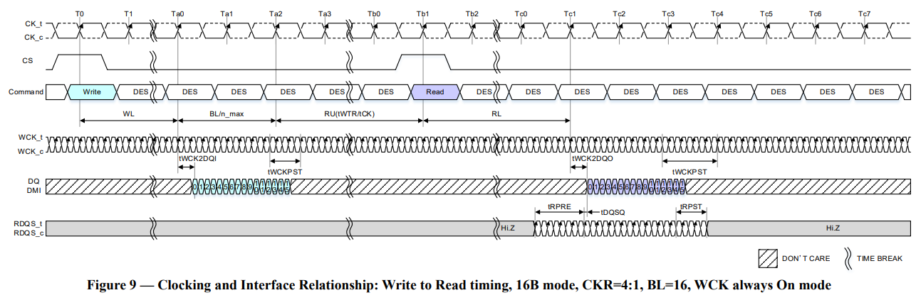
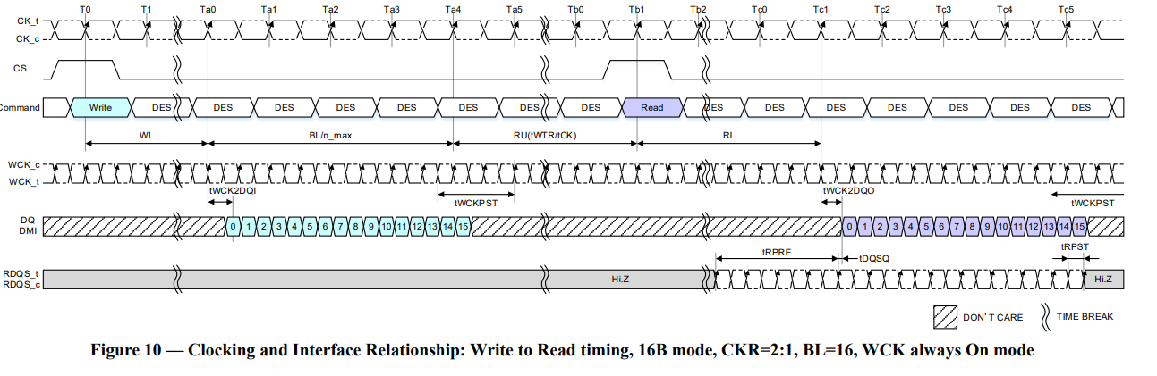
Waveform Extraction
Step1:
From the given PDF, waveform is located and extracted as a single image.
This detection is done using the post processed text data and using the Figure names.
This also handles the case where there are multiple waveforms on the same image.
Each waveform is extracted as a separate image.

Slide 16

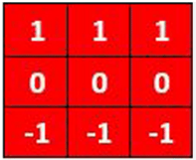
Waveform Extraction
Arrows
(Computer vision + CNN Training based)
Non- Arrows
Step2:
A Horizontal Kernel of size 3x3 is swept across the image and all the horizontal lines are filtered out.
Each Horizontal line is stored as a separate patch of the image.
A CNN model (3 layered CNN) with binary cross entropy loss is function is trained to predict weather each patch is an arrow V/S non-arrow.

Slide 17
Waveform Extraction
PDFPlumber
(Map PDF to Image Coordinates)
(X_ratio, Y_ratio)
Step3:
Text is extracted from PDF using PDFPlumber (source code of PDF taken into account)
Text extracted for timing is mapped to the arrows detected.
Arrows detected + Timing information are mapped to the Clock pins and Start/ End command.

Slide 18
Waveform Extraction
`
``
``
``
``
`
`
`
`
``
``
`
`
`
``
``
``
``
``
``
``
``
`
``
``
`
``
``
`
``
`
``
``
``
Step4:
Text information about pins present in left vertical section of the image are extracted (Blue Boxes).
Common-to-command information is also extracted.
All information is linked together to get the C2C Timing data for each waveform.

Slide 19
Waveform Extraction: More Examples
(Multiple waveforms on same page)

Slide 20
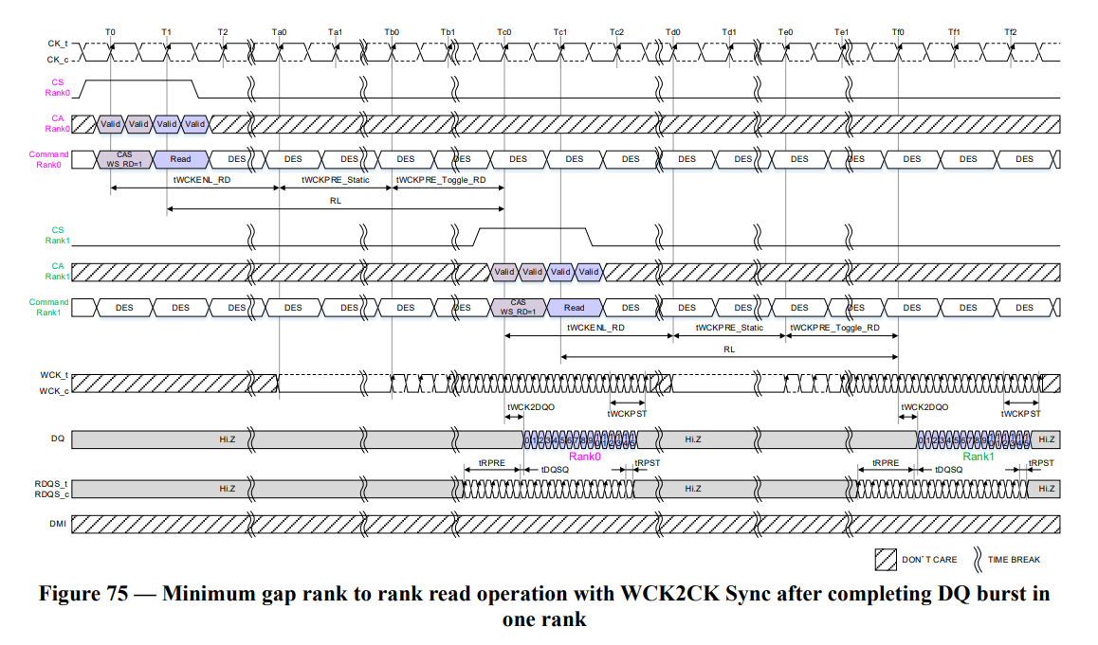
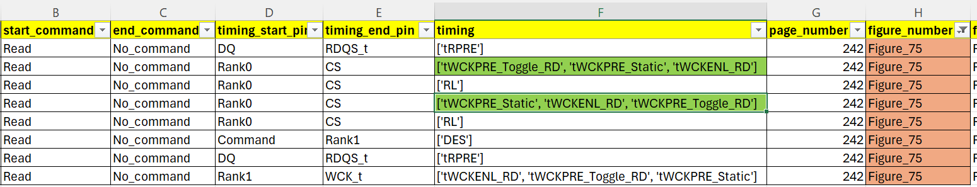
Waveform Extraction: More Examples
(Timings in same alignment captured together as a single entry)
Similar results generated on all 335 images from JEDEC.
Additional information related to Bank/ BG Group/ DVFSQ/ CS ODT etc. are also captured for each waveform.

